Slide 1
Database
Alina Kazanskaya
David Nakar
Michal Shaffer
Ayo Farinre
Ralph Betesh
Andreas Tyre

Slide 2
1500+
Tons
21+
A lot of
15+
Too much
Lines of code
Of comments
Functions
WhatsApp Messages
Sql Objects
Coffee

Slide 3
Initial Tasks
Create a database design
Find a host
Create tables, views, etc…
Create sql queries
Create Python module
Create Python routes
Import sample data

Slide 4
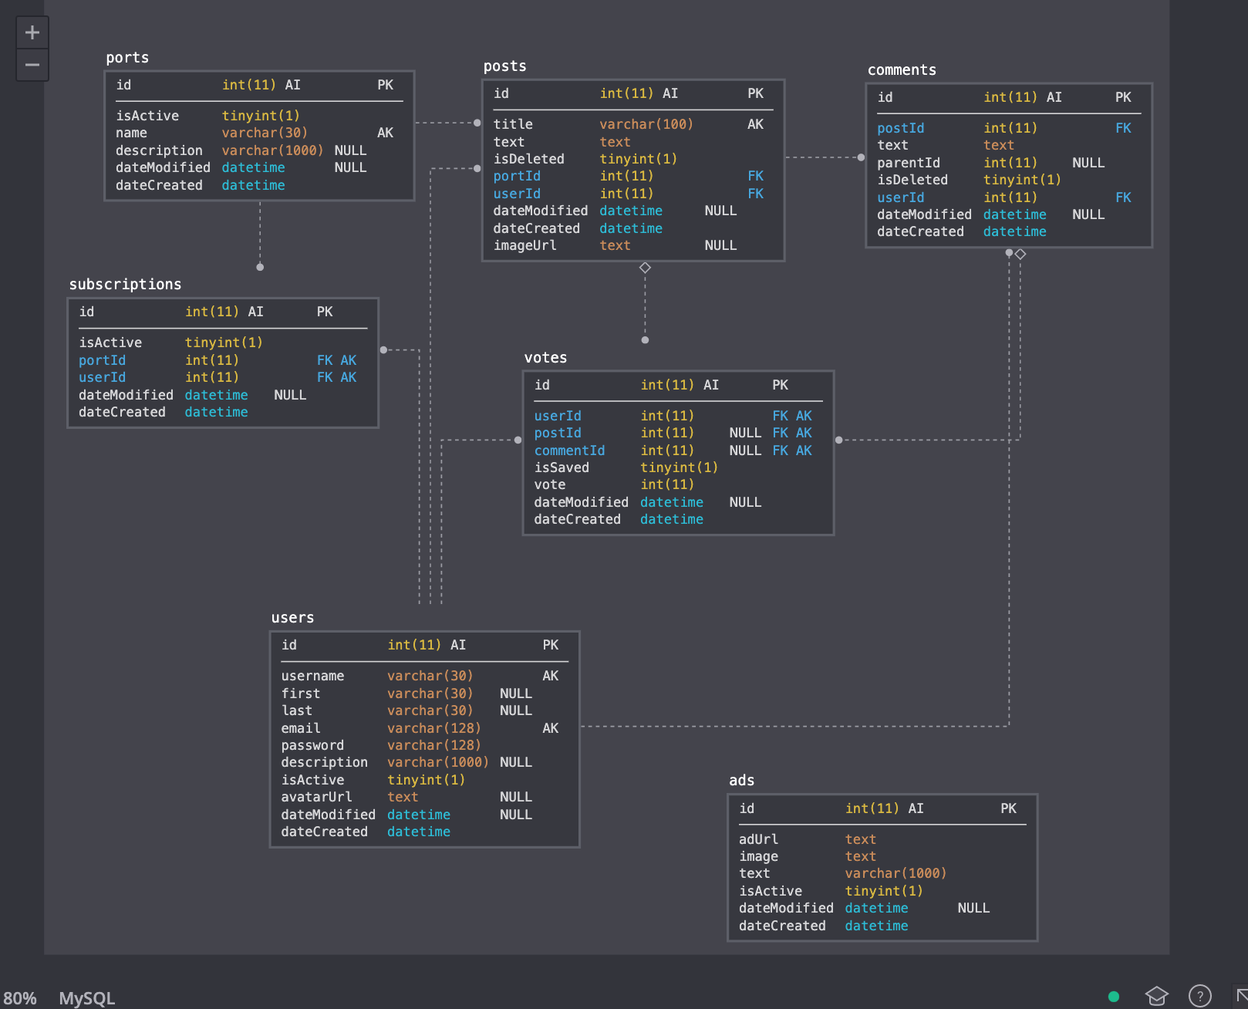
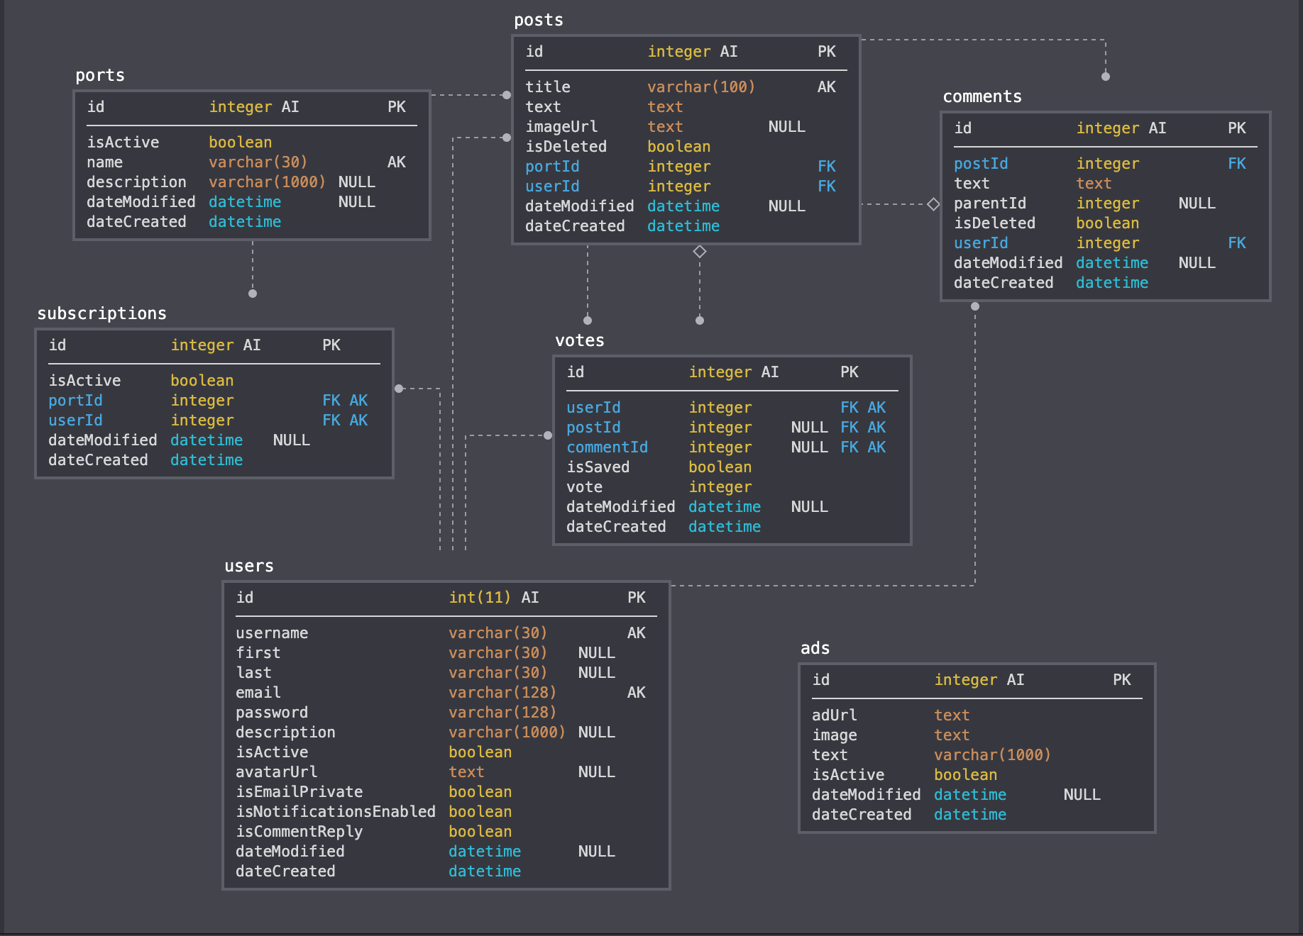
Table Design
Ads
Users
Comments
Subscriptions
Posts
Ports
Votes

Slide 5
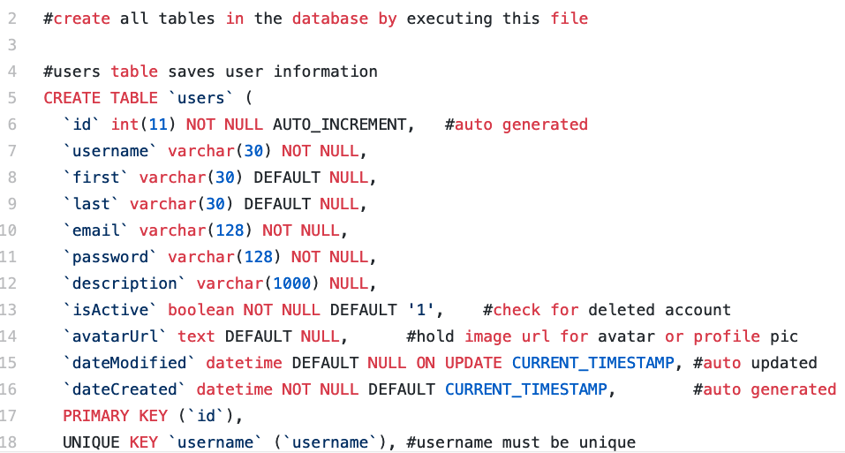
Creating the Tables

Slide 6

Host
Moncks Corner, South Carolina

Slide 7

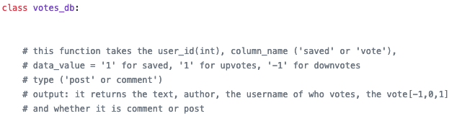
Code Documentation
All code was documented and explained so that other teams were able to understand it with ease.

Slide 8
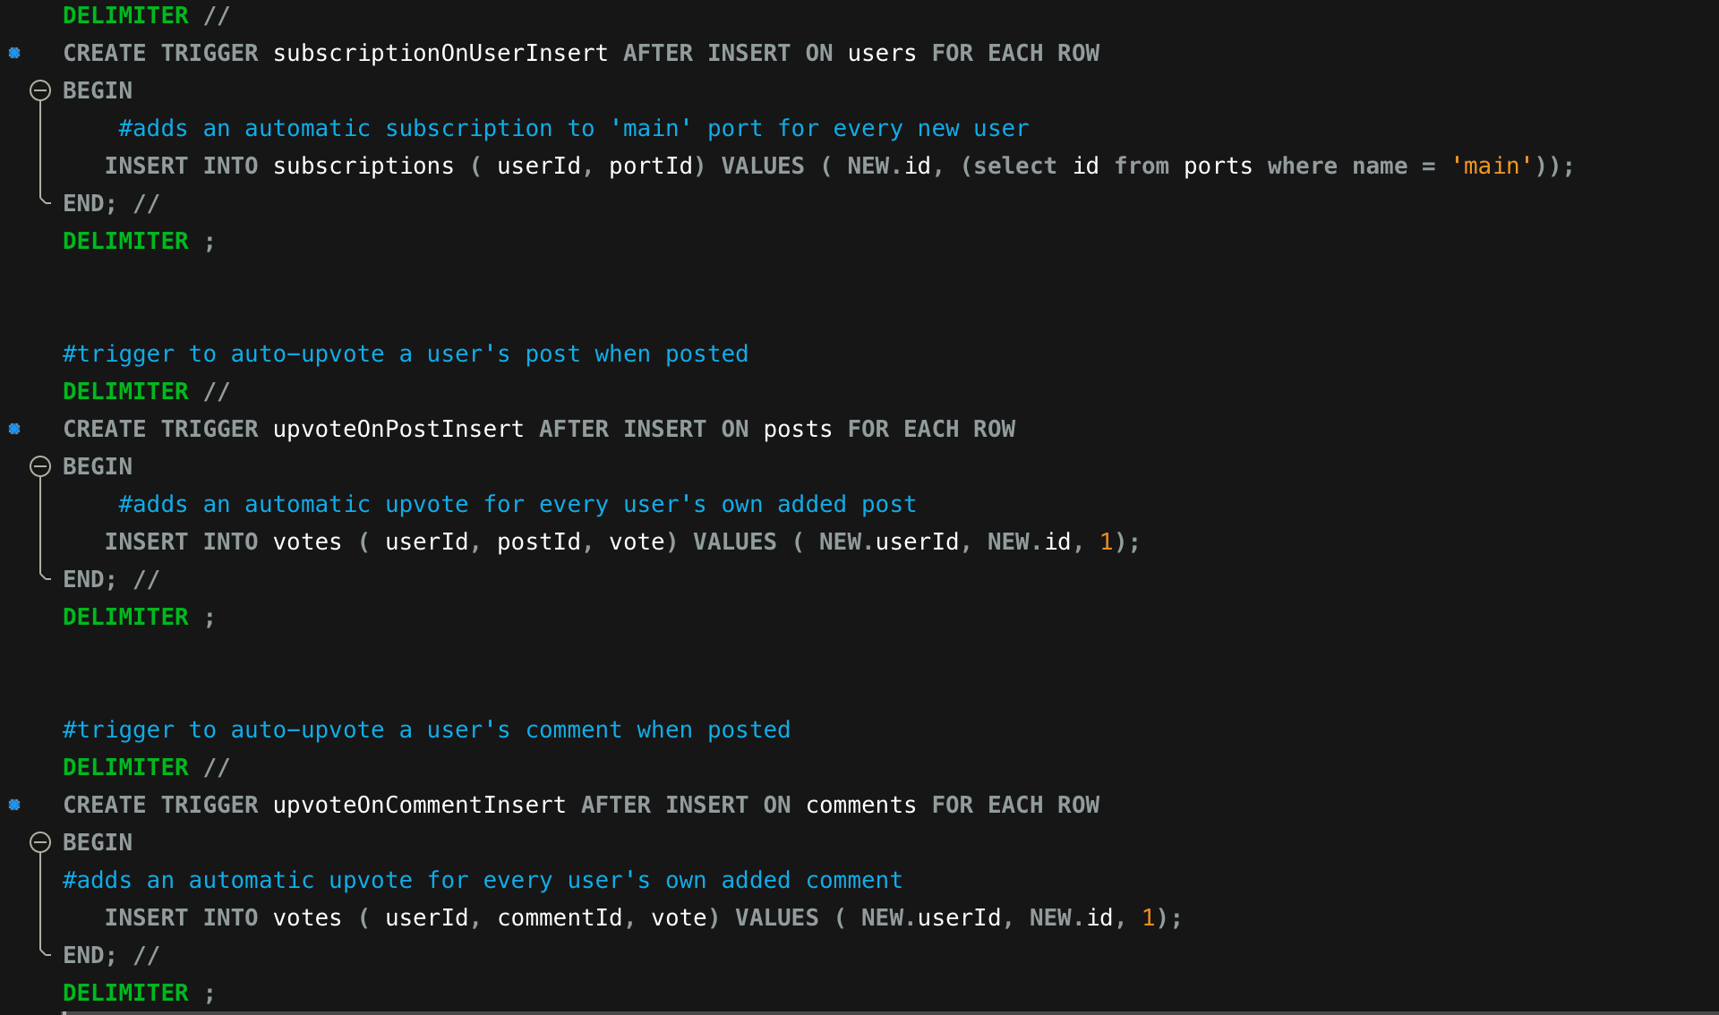
Triggers
subscriptionOnUserInsert
upvoteOnPostInsert
upvoteOnCommentInsert

Slide 9
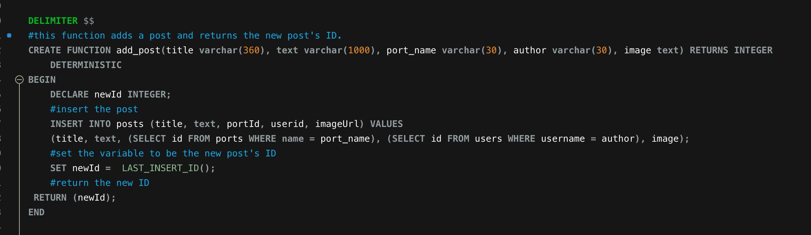
Stored Functions
add_post()

Slide 10
Views
users_vw
comments_vw
Votes_vw
subscriptions_vw
posts_vw

Slide 11
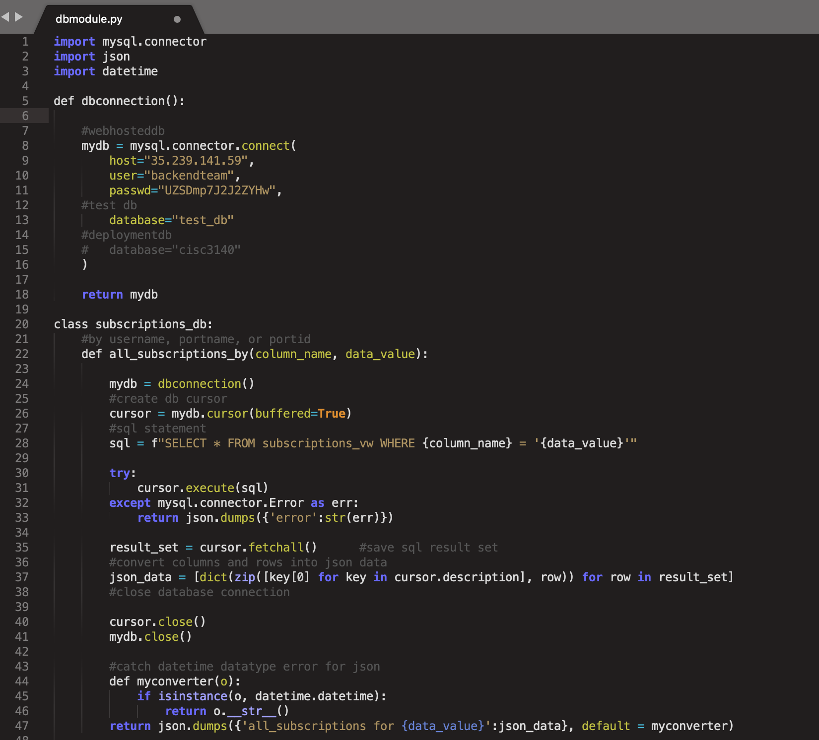
Python Functions
*a quick walk-through...

Slide 12
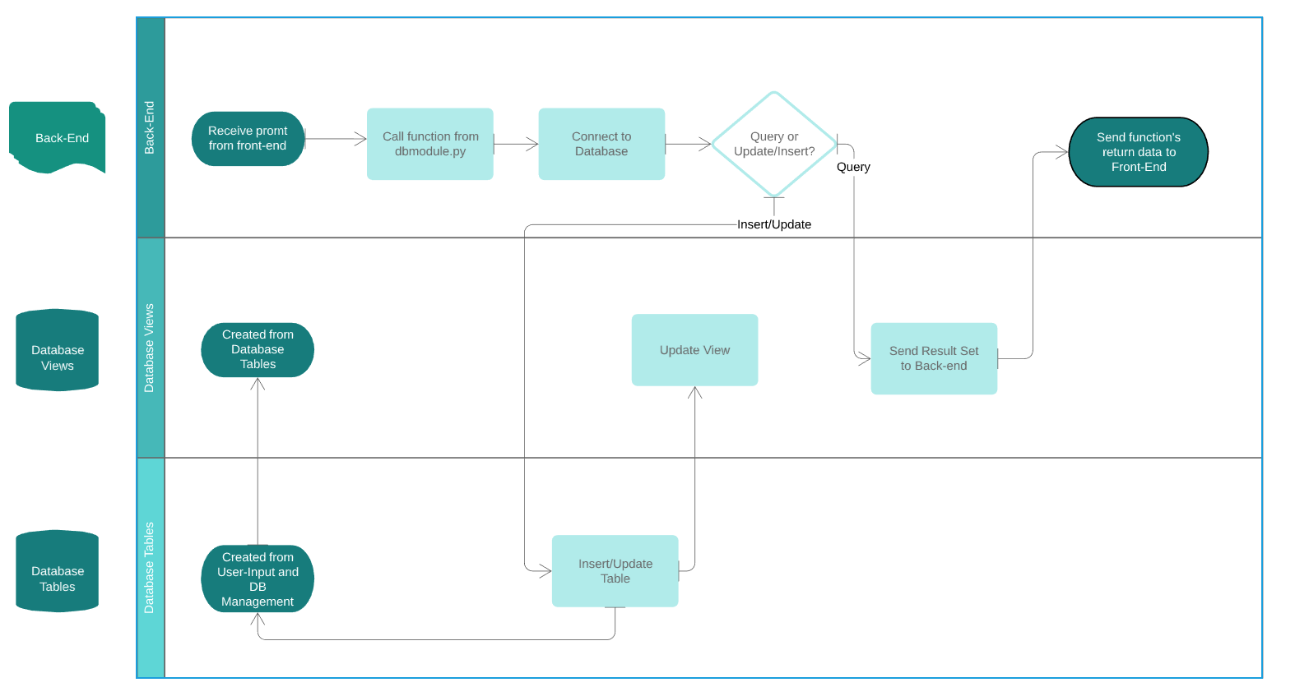
Data Flow Diagram

Slide 13
Further Tasks
Redundancy within code
Database connection & password is accessible in the dbmodule file
Stored functions/and or procedures in mySql for each insert couldn’t be implemented.

Slide 14
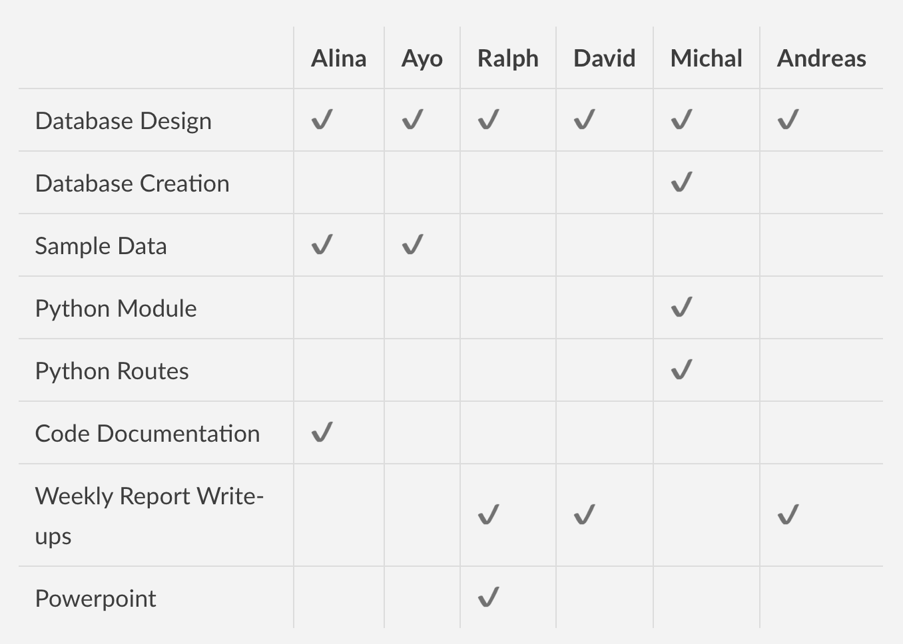

Initial Division of Labor

Slide 15
Challenges & obstacles
Obstacles
Finding a free host that made it easy for other teams to connect to
Connecting with other teams after class
Bugs or errors in our functions and tables
Collaboration
WhatsApp
Github Issues
Group Class time

Slide 16





Useful Tools
sqldbm.com
mySql
Google Docs
Github
Google Cloud Platform
mySql Workbench
Sublime
PyCharm
lucidchart
Notes:
app.sqldbm.com for initial database design
mySql documentation for fixing bugs, looking up syntax, etc
Google docs for working on weekly reports, etc
GitHub for obvious reasons
GitHub Issues for collaborating with teams and fixing bugs
Google Cloud Platform for hosting our DB
mySql Workbench for working inside the DB
Sublime, Pycharm for working with python and SQL code

Slide 17
Weekly Report #4
Completed:
Added new columns to the users table at front-end request
Updated views at back-end request
Worked with back-end to fix issues
Updated the database time-zone to reflect EST
Added more comments and documentation
Created a data-flow diagram with www.lucidchart.com
Looking Forward:
Moving over to deployment database from testing
Cleaning up functions to remove redundancy
Add db functions to replace insert statements
Moving database to a host that won't expire after the trial period

Slide 18

THANKS!
Any questions?
Alina Kazanskaya
David Nakar
Ayo Farinre
Ralph Betesh
Andreas Tyre
Michal Shaffer

